Slide 1
National Central University
Graduate Institute of Industrial Management
The Oral Defense
Thesis Title: Applying Genetic Algorithm to Schedule Brewery Production
Name: Bui Xuan Toan
ID: 104426602
Nationality: Vietnamese

Slide 2


Problem Definition
The characteristics of brewery production:
Two major processes: fermentation and bottle filling.
Two major types of machines: fermentation tanks and filling lines (bottle or can).
Problem: the bottleneck of the production process move between two types of machines.
Filling lines wait for liquid to be mature to filling bottle/can.
Mature liquid in tanks wait for free filling line to be filled.
Question: How to reduce congestion and increase productivity in brewery production.

Slide 3
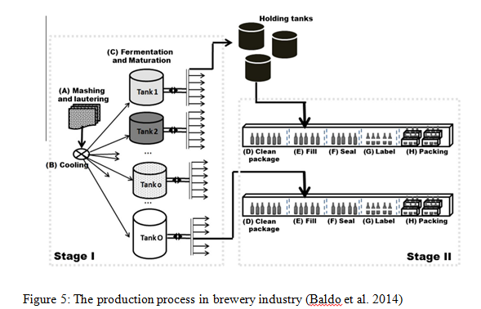
Production Process

Slide 4
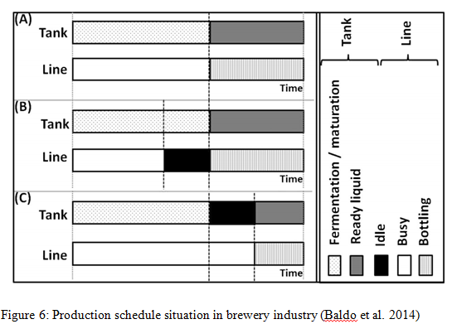
Problem in Brewery Production
Notes:
The problem is described by Baldo at al 2014.
A, perfect ready liquid go to filling line immediately.
B, filling line has to wait for fermentation process in tanks
C, Tank has to wait for filling line to be available.

Slide 5

Solution Approach: General Ideas
The jobs assignment to tanks problem will be formulated as a simple math model.
The synchronization between the two production stages will be formulated as a flexible job shop scheduling problem (FJS).
The goal: find a plan that minimize makespan of a given demand

Slide 6
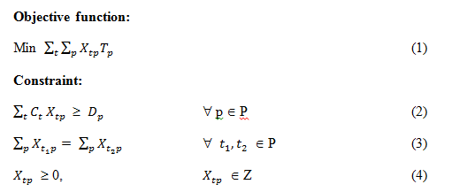
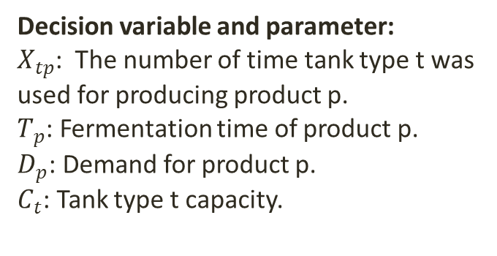
Math Programming: Job Assignment
Set:
p ∈ P with P is a set of products.
t ∈ T with T is a set of tank types.
Decision variable and parameter:
$X_{tp}$: The number of time tank type t was used for producing product p.
$T_{p}$: Fermentation time of product p.
$D_{p}$: Demand for product p.
$C_{t}$: Tank type t capacity.

Slide 7
Math Programming: Job Assignment
(1) minimize the fermentation time of a given quantity demand.
(2) make sure that the demand always be fulfilled.
(3) make sure that tank types assignment are use equally.
(4) the valid condition of decision variables

Slide 8
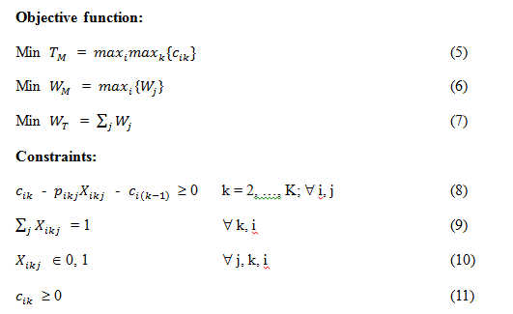
Synchronization with FJS: Model Description
Set:
i ∈ I with I is a set of jobs.
j ∈ J with J is a set of machines.
k ∈ K with K is a set of operations.

Slide 9
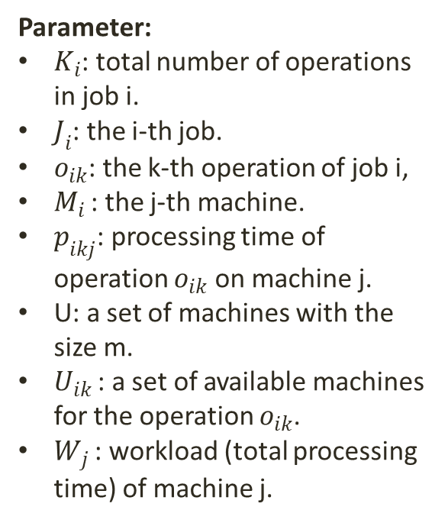
Synchronization with FJS: Model Description
Parameter:
$K_{i}$: total number of operations in job i.
$J_{i}$: the i-th job.
$o_{ik}$: the k-th operation of job i,
$M_{i }$: the j-th machine.
$p_{ikj}$: processing time of operation $o_{ik}$ on machine j.
U: a set of machines with the size m.
$U_{ik }$: a set of available machines for the operation $o_{ik}$.
$W_{j }$: workload (total processing time) of machine j.

Slide 10
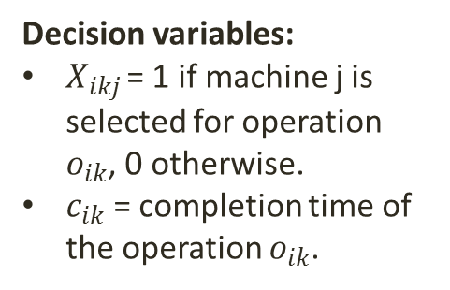
Synchronization with FJS: Model Description
Decision variables:
$X_{ikj }$= 1 if machine j is selected for operation $o_{ik}$, 0 otherwise.
$c_{ik}$ = completion time of the operation $o_{ik}$.

Slide 11
Synchronization with FJS: Model Description
(5) is to minimize the makespan of all the jobs.
(6) and (7) consider the total processing time and dispatching the operations averagely over machines.
(8) the successive operation has to be started after the completion of its precedent operation of the same job.
(9) one machine has to be selection for each operation.
(10) and (11) are the valid condition for decision variable.

Slide 12
Solution Approach: Assumption
The fermentation time of a product is fixed and unrelated with the volume of production.
while the bottle filling time is related with the production volume and filling machines capacity in a linear fashion.
The filling operation can only process when the fermentation operation is finished.
A machine can only process an operation as a time.
A machine can only process a set of operations base on their function.
A job will enter the machine immediately when the previous job is finished.
Notes:
Give some example.

Slide 13

Synchronization with GA
There are two decisions in FJS:
Machine selections (which machine to process an operation).
Sequence decisions (the order of operations)
The operation sequence constraints are need to be reserved.
Question:
How genes can be present a solution.
How to compute fitness value of a genes (how good solution presentation is)
How to do genetic operations (cross-over, mutation)

Slide 14
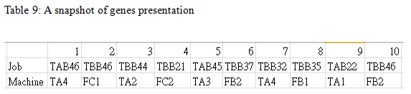
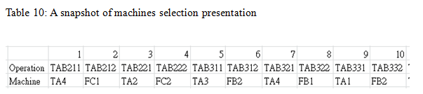
Genetic Presentation

Slide 15
Sequence Decision Presentation
Each operations sequence will be presented by a list of job.
The sequence decision is read from left to right.
Example: the first job coding ‘JAB46’ will present the operation coding ‘JAB461’, the first job coding ‘TBB46’ will present the operation coding ‘TBB461’, the second job coding ‘JAB46’ will present the operation coding ‘JAB462’ and so on.

Slide 16
Machine Selection Presentation
The machines selection is reference with a fixed list of operations.
The coding of the operation give us the information about the operation itself, therefore we can use it reference to a set of machine that can process the operation.
Example: ‘TAB211’ is fermentation operation of product B2 on tank type A, and ‘TAB212’ is the filling operation of product B2.

Slide 17
Decoding Genes to Plan
Input: genes presentation, operations list, processing time table.
Output: the plan like a dictionary with key is (‘operation’, ‘machine’) and value is starting time and completion time.
Step 1: from the genes presentation get a set of machines and a set of jobs.
Step 2: from a set of machines and a set of job create a dictionary of machines time and jobs time to keep track of machine time and jobs time. Machines time is to keep track of the current processing status in machine aspect. Job time is to keep track of the current processing status in job aspect.

Slide 18
Decoding Genes to Plan
Step 3: For each operation on the sequence decision:
Step 3.1 get the operation time of the current operation on the chosen machine from the processing time table.
Step 3.2: update the machines time of the chosen machine by operation time, update the jobs time of the current operation by the operation time.
Step 3.3: get the completion time of the current operation by choosing the maximum of machines time of the chosen machine and the jobs time of the current job.
Step 3.4: compute the starting time of the current operation by the completion time of the current operation – processing time of the current operation.
Step 3.5: update both machines time of the chosen machine and the jobs time of the current job by the completion time of the current operation.
Step 3.6: get the starting time and completion time of the plan (‘current operation’, ‘chosen machine’) by the current starting time and completion time respectively.
Step 4: return the plan

Slide 19
Design of An Individuals
Each individuals is presented by genes and fitness of genes.
The fitness of individual genes is design with 3 attributes:
The last time to finish all the jobs.
The maximum workload of a machine.
The total workload of all machines.
The fitness of an individual is design with hierarchical structure to compare the fitness between individuals:
The first priority is the last time to finish all the jobs.
The second priority is the maximum workload of a machine.
The third priority is the total workload of all machines.

Slide 20
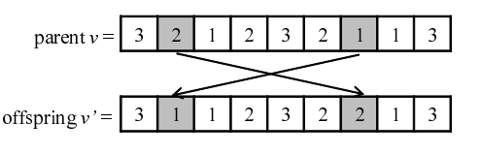
Genetic Operations: Mutation
On sequence decision genes: randomly selection two genes and swap them.
➔ Since each gene in the sequence decision genes is job coding combine with the decoding mechanism, therefore the mutation of on sequence decision does not create invalid genes.
Figure 11: Illustration of job pair exchange mutation (Mitsuo et al. 2008)

Slide 21
Genetic Operations: Mutation
On machines selection genes: randomly select an operation in the operations set, and choose the machine that can process that operation.
➔ Therefore, mutation on machine selection also does not create invalid genes.

Slide 22
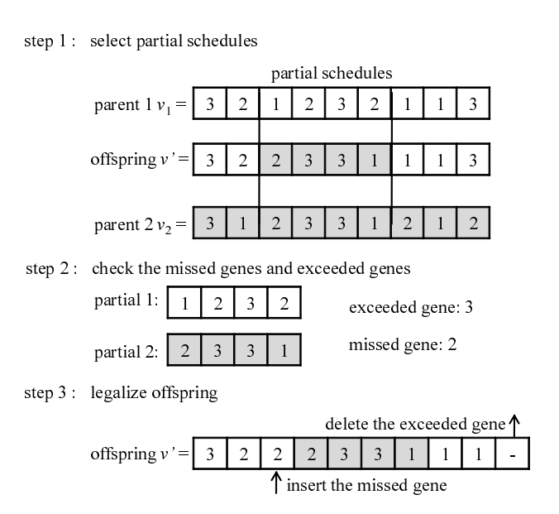
Genetic Operations: Crossover
Crossover operation on sequence decision genes:
Frigure 12: Illustration of extended order crossover (Mitsuo et al. 2008)

Slide 23
Genetic Operations: Crossover
Crossover operation on machine selection genes:
cutting the two parent genes at the middle point and combining them in two new genes.
Since machine selection genes is reference to a fixed operation list. Therefore the crossover operation does not create invalid genes

Slide 24
Populated GA: Parameters
The proposed populated GA has some parameters as flowing:
Population size: the number of individuals in a generation. Each generation is an evolution loop of the proposed GA.
Number of generation: the number of evolution loops. It is also the exist condition for the proposed populated GA.
Crossover probability: the probability to apply crossover operation.
Mutation probability: the probability to apply mutation operation.

Slide 25
Populated GA: Pseudocode
Input: population size, mutate and crossover mechanism, the probability of mutation and crossover, number of generation.
Output: the best individual.
Step 1: initialize the population randomly with given population size.
Step2: create an empty list to keep track of the best individuals through generations

Slide 26
Populated GA: Pseudocode
Step 3: for n in the number of generation:
Step 3.1: randomly select individuals to apply mutation and crossover mechanism with the given probability.
Step 3.2: compare between the new individuals and their parents, choose the better individuals.
Step 3.3: put the better individuals back the population.
Step 3.4: find the best individual in the current generation.
Step 3.5 if the current best individual is better than the last best individuals, append to the list of best individuals.
Step 4: return the best individual from the best individuals list.

Slide 27

Case Study: Sabeco
Sabeco is the largest brewery producer in Vietnam.
In 2013 Sabeco produced 1,330 billion litter of beer.
The company has around 24 plants in Vietnam with the capacity of 1.8 billion litters.
Fermentation Tanks Capacity: 1000 BBL or 500 BBL (1 BBL (barrel) = 1.17 hectoliters (hl), and 1 hectoliter = 100 liters (l), 1 litter = 1000 milliliters (ml), ml is the volume measure for beer bottle or can in Vietnam)
Filling line capacity:
Can filling line capacity: 30.000 cans/hour.
Bottle filling line capacity: 35.000 bottles/hour
Source: sabeco.com.vn

Slide 28

Sabeco Product Set

Slide 29
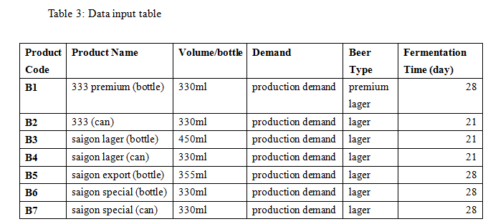
Sabeco Product Set

Slide 30
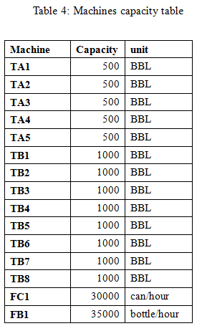
Sabeco Machine Set

Slide 31
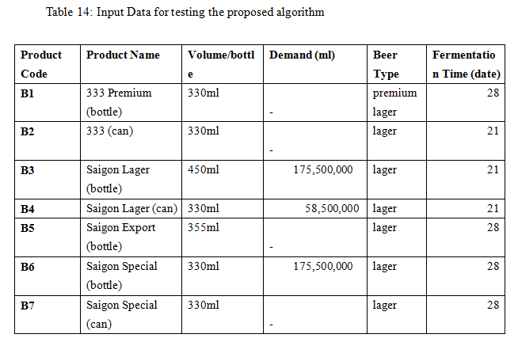
Sabeco Small Test Case
Notice: The test case size is small in purpose that the result plan is easy to be validated.

Slide 32
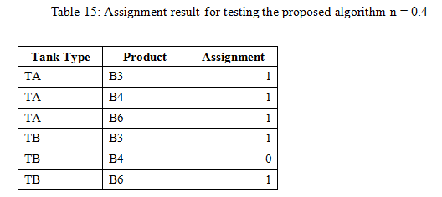
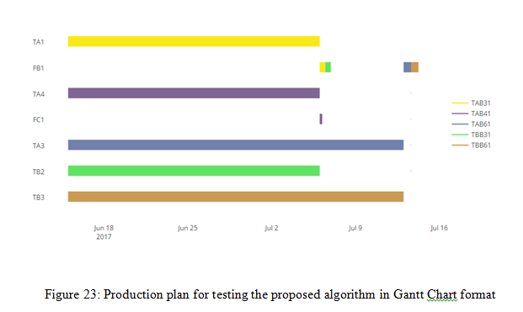
Sabeco Small Test Case

Slide 33
Sabeco Small Test Case
Table 17 shows tank types assignment result for the testing problem.

Slide 34
Sabeco Small Test Case
The sequence constraint of operations in the same job is reserved.
In this case filling stage can only take place when fermentation stage is finished.
A machine can only process one operation as a time, and a machine can only process a set of operations base on their function.
In this case, the bottle filling line can only fill bottle products, the can filling line can only fill can products.

Slide 35
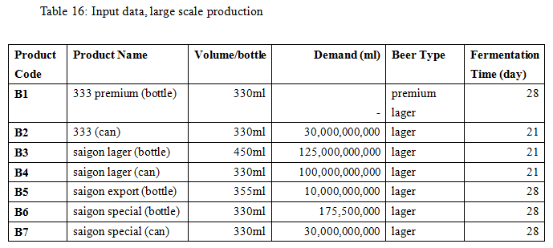
Sabeco Industrial Test Case

Slide 36
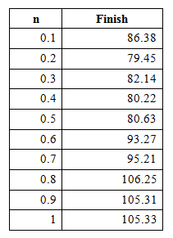
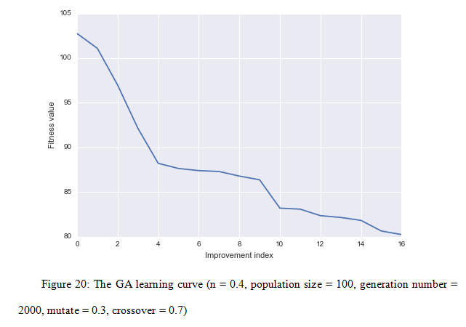

Sabeco Industrial Test Case
Table 17: Scenario analysis for synchronization (population = 100, generation = 2000, mutate = 0.3, crossover = 0.7)

Slide 37
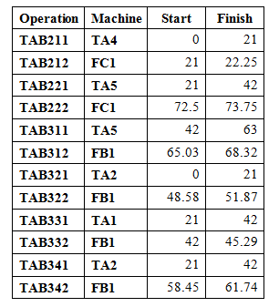
Sabeco Industrial Test Case: Plan Presentation and Validation
Table 18: Plan presentation in job and operation perspective, a snapshot
In Table 18, the resulting plan is sorted in term of jobs and operations.
It helps us check the sequencing constraint of operation in the same job, that is the flowing operations have to be later the precedence operations of the same job.
In this case the filling operations have to be later than the fermentation operations

Slide 38
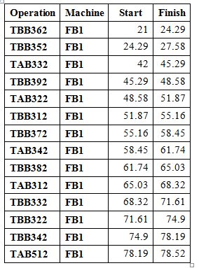
Sabeco Industrial Test Case: Plan Presentation and Validation
Table 19: Plan presentation in machine and time perspective, a snapshot
In Table 19, the result plant is sorted in term of machines and times.
It helps us the check the validation of job processing, that is a machine can only process one job as a time (no overlapping time between operations in one machine)

Slide 39
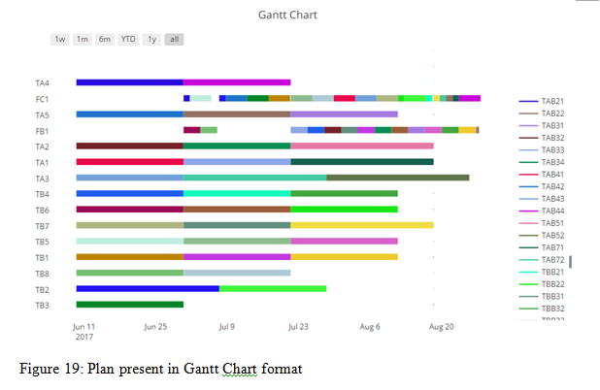
Sabeco Industrial Test Case: Plan Presentation and Validation
In figure 19, the whole resulting plant is presented in Gantt Chart format, which helps us visualize the hold plan

Slide 40
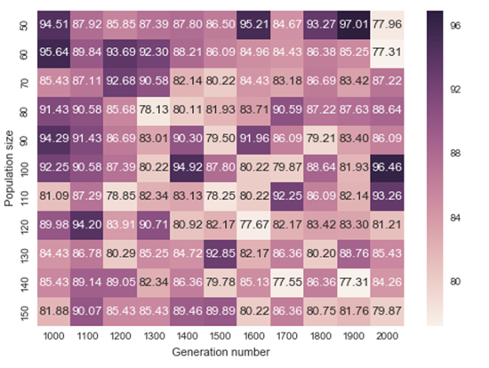
Experiment on Parameters
Population size and Number of generations:

Slide 41
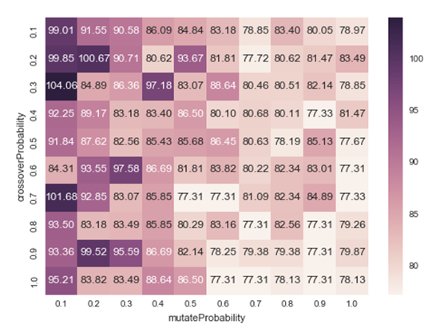
Experiment on Parameters
Mutation and Crossover Probability

Slide 42
Conclusions
New Contributions:
The brewery scheduling problem is formulated as FJS problem and a simple math programming assignment problem.
Three different presentations of the schedule plan are introduced to validate the schedule result.
Several experiments are conduct to investigate the relation between population size and number of generations, the relation between crossover probability and mutation probability.

Slide 43
Conclusions
Limitations and Further Research:
Firstly, the tanks assignment and synchronization between fermentation and filling stages are done separately.
Secondly, the proposed approach is based on flexible jobs shop scheduling problem, therefore the processing time of a given operation on a chosen machine is fixed. However, in the real industrial production case, the liquid in fermentation stage can state in the tank longer than their fermentation time waiting for filling in bottles.

Slide 44
Thank You

